Slide 1
Predicting Fuzzer Performance from Program Metrics
By Anna Kovalsky
Notes:
Hello everyone, my name is Anna Kovalsky, and I’ll be presenting my project on predicting fuzzer performance.

Slide 2
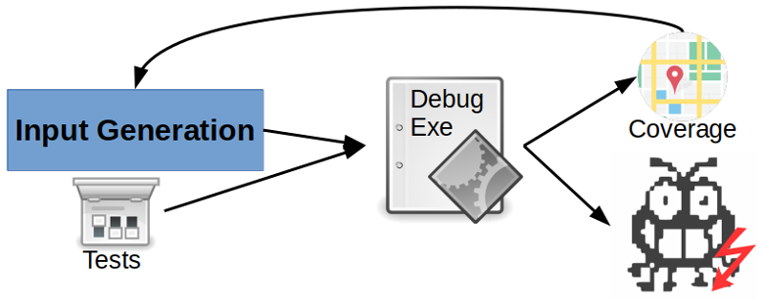
Background: Fuzzing and Comparing Fuzzers
Fuzzing: dynamic analysis method that generates random inputs to find bugs
New fuzzer created almost every year
Recent effort to compare fuzzers
Google Fuzzbench
Papers
Fuzzbench publishes its tests every week; very good data
Fuzzers ran against 20 benchmarks, at least ten times, for at least 24 hours
Benchmarks are varied
Performance varies based on benchmark type
Performance = code coverage
Notes:
So, before we begin, we need a baseline understanding of fundamentals and how I thought of this project in the first place.
So, first, what is a fuzzer?
A fuzzer is a dynamic analysis tool that searches for program vulnerabilities by generating thousands of random inputs and saving any unusual behavior the program may have in response to those inputs.
It is an incredibly easy-to-use bug testing method, and as such, there is a new fuzzer created almost every year. There are many, many fuzzers available, and because of that, there has been a growing effort to compare and rank these fuzzers. Comparison usually involves counting and comparing code coverage.
For example, Google created a tool called Fuzzbench that simultaneously and automatically tests your fuzzer against about 20 different benchmarks multiple times in multiple separate Google Cloud VMs. Each benchmark usually runs at least ten test runs for 24 hours each, which is very good for getting solid values.
And, Google publishes these test results about every week. A quick glance at these results, shown in this page, shows obvious performance differences between different types of benchmark programs. An example is Honggfuzz fuzzing image programs and libraries much better than AFL. This implies that there is something different about image programs that improve Honggfuzz’s performance.
There have also been a couple of papers discussing either standardizing fuzzing comparisons or just introducing their own tools to compare fuzzers

Slide 3
Program Metrics and Motivation
Program metrics can be used to improve fuzzer performance
Intuitively, if you can improve performance with program metrics, then you can also predict performance with program metrics
No papers published about predicting fuzzer performance
Problem:
There are a lot of fuzzers available, and no easy way to choose which one is the best
There are differences in fuzzing performance based on program type, so while an overall “best” fuzzer is useful, finding the best fuzzer for the type of program you have is more useful
Notes:
On the other side, there have been several papers discussing how to improve fuzzing performance using program metrics like cyclomatic complexity, the Halstead metrics, lines of code, code depth, and so on.
So, knowing that you can improve performance with program metrics, it’s easy to intuit that you can predict performance given program metrics.
However! There are no papers about predicting fuzzer performance, and I have looked all semester.
This is a problem. There are literally hundreds of fuzzers available, and, frankly, after a while their descriptions start sounding the same. How can a user know which fuzzer has the best chance at finding bugs in their program? I mean, they could just use the most popular fuzzers, or look through curated lists of fuzzers, but that’s not an easy solution.

Slide 4
Goal: Predict Performance
Two goals:
Show that I can predict performance
Actually predict fuzzer performance
Let’s see how
Notes:
So, my goal was to first show that I can predict performance and then create a tool that does predict performance based on program metrics.
I succeeded... mostly.
So, let’s talk about what I did.

Slide 5
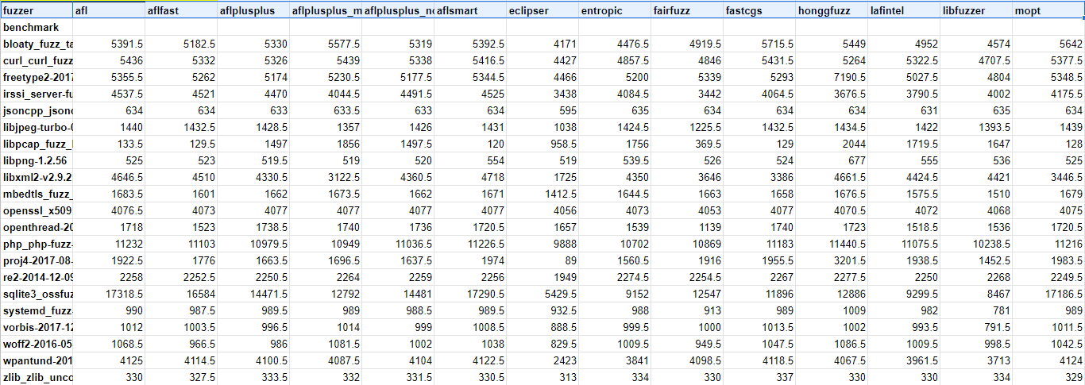
Implementation: Gathering Performance Data
First, I need performance data
I used Fuzzbench for the performance data
Performance data = median code coverage data
Higher is better.
Notes:
The first step in predicting stuff is gathering enough data to create a regression. So, what data did I need?
First, I needed performance data of fuzzers for various programs, that is the dependent variables.
Getting the performance data was easy. I used Fuzzbench’s publicly published reports for performance data. They deleted the report I used, but I saved it locally. Here you can see a sample of the data. I used the median performance of each fuzzer. There were 15 fuzzers and 21 benchmark programs. So, in total, I had 15 dependent variables and 21 sets for independent variables.
The next part was a bit harder.

Slide 6
Implementation: Gathering Program Metrics
Used 2 static analysis tools to gather program metrics
SourceMonitor
Free
Provided 14 metrics; 7 were usable because of collinearity
CPPDepend
41 program metrics; 20 usable
27 rules metrics; 16 usable
Rules metrics are coding standard violations
Each of the 20 benchmark programs were run through SourceMonitor and CPPDepend
Data found here
Notes:
For the second step, I needed enough program metrics from each of those benchmark programs. This would be the independent variables.
There is no free and easy way to get a lot of high-quality program metrics for multiple programs. So on this step, I split my efforts. First, I found a free static, source code analysis tool called SourceMonitor that provided about 14 different program metrics like number of files, lines of code, statements, functions, complexity, etc. Only 7 of them were usable in a regression because the other 7 were collinear.
Second, I found a non-free static analysis tool with a free trial period. CPPDepend provided about 41 different program metrics at the project level, though only about 20 of them were usable because of collinearity. CPPDepend also provided a different type of program metrics called Program Rules, which is just the number of times the program violated various coding standards. There were 27 rules, but only about 16 were usable.
I compiled program metrics for all 20 benchmarks using both SourceMonitor and CPPDepend into separate tables.
The tables are rather large, so let me just pull up the file with them. You can see all three of my program metrics tables here.

Slide 7
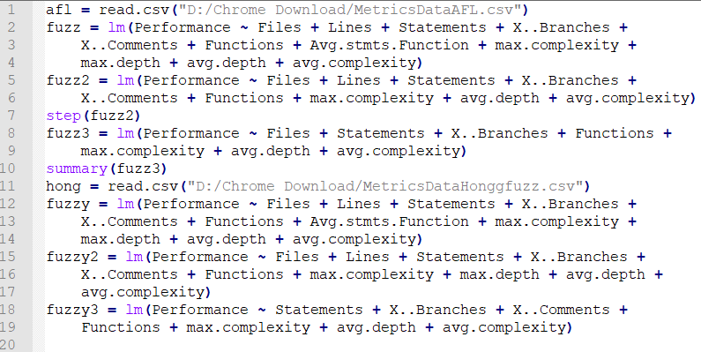
Implementation: Regression Model
Used RStudio to make a stepwise regression function
This is a sample of the R code I used for this part
Notes:
So, after gathering both dependent and independent variables, I was ready to make a stepwise regression function.
I had help from a friend who is a statistics major in this part, because I have no experience using RStudio. Here you can see a sample R script I used to create a stepwise regression function.
Basically, the script reads the CSV containing both metrics data and performance data, and then it simply uses R’s lm function to create a regression, then step to remove unnecessary variables, and then summarize. It’s very straightforward.

Slide 8
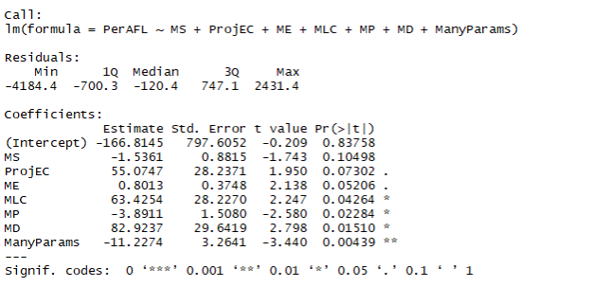
Sample RStudio results
Notes:
Here you can see the a sample of the results RStudio gave me. I exported these results into another CSV.
The regression formula that you can see here is the sum of the products of estimates and raw metrics plus the intercept.

Slide 9
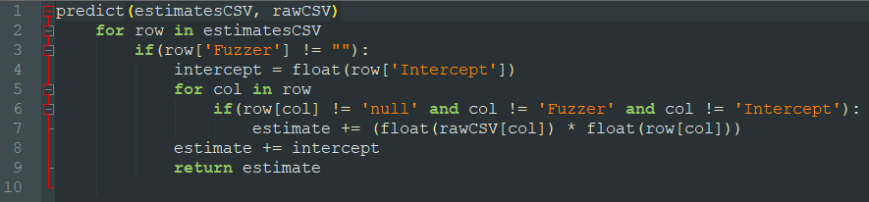
Implementation: Tool
Program written in Python
Very simple calculator; input is 2 CSVs.
Estimates CSV is constant. Uses estimates and intercept from regression formula
Raw CSV is the user input
Algorithm converts CSV into dictionary and simply sums the products estimate*raw together
Notes:
Finally, after gathering all that data and creating a regression formula for each fuzzer, I could create a tool that predicts performance.
Now, the general algorithm itself is very, very simple. It’s basically just a calculator. Essentially, I set up another two CSVs, one that is the raw program metrics input that a user might generate and another that contains the estimate values and intercept from the regression formula.
The program first transforms both CSVs into dictionaries. Then, the program reads through the estimatesCSV dictionary and uses the column names as keys when searching for the correct raw values in the rawCSV dictionary. Then, it multiplies the estimate with the raw value and adds it to the running total. At the end, I add the intercept and return the prediction to print elsewhere or save it in a file.
I’m not sure if I have time right now to show a quick demo, so I’ll show it later if I have time.

Slide 10
Results: Estimation Evalution
First, I found how far away the estimates were as a percent.
Sourcemonitor, estimate / real * 100 averages
.
.
CPPDepend Metrics, estimate / real * 100 averages
CPPDepend Rules, estimate / real * 100 averages
.
Full data can be found here
Notes:
So, now that we talked about why and how I did this project, let’s talk about how well it works.
The full tables can be found here. I’m just showing averages because the full tables are too big. https://docs.google.com/spreadsheets/d/1mRYi4km1P-qC8SpPC1vTSHQIraeaB472sijRgXdy50o/edit?usp=sharing
So, I checked two things to see if the predictions work. First, I checked how close the predictions were to the real values. As you can see here, on average, both SourceMonitor and CPPDepend using program rules overestimated by at least twice, in general. The predictions based on CPPDepend using program metrics, meanwhile, still generally overestimated, but by a smaller amount. All three predictions had very high variance, however. This means the estimations could be better.
However, the point of this tool is to tell you which fuzzer would be the best for you, so I also checked if my tool correctly placed the top 5 best fuzzers in the top 5.

Slide 11
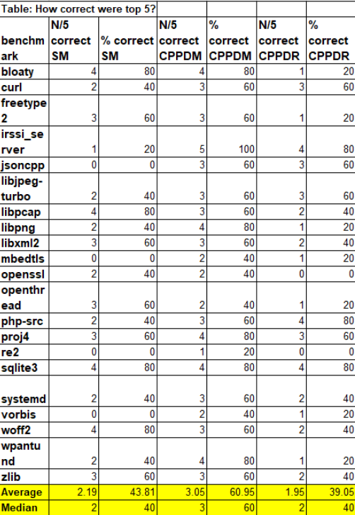
Results: Ranking Evaluation
CPPDepend using metrics consistently had at around 3 correctly ranked fuzzers in top 5
The other two data sets were worse--only placing around 2 fuzzers in the top 5 correctly.
This is workable.
There is room for improvement, however
Notes:
As you can see here, again, CPPDepend using program metrics had around 60% of the top 5 as correct. That means that it would, on average, have around 3 fuzzers correctly ranked in the top 5. This is workable.
The results show that while the regression model generally overestimated, and the variance was pretty high, because it was still more than 50% correct about its top 5 ranking, it is workable.
There is, of course, room for improvement, so let’s talk about how I could improve this project for the future and possible reasons why it was off this time.

Slide 12
Future Work and Improvements
Improvements
Need more observations; can use Fuzzbench to add more benchmarks to improve predictions
CPPDepend data needs to be regathered because there was some problem running it on Windows
Collinearity needs to guaranteed removed; factor analysis can be done next time
New directions
“Not All Coverage Measurements are Equal” showed a new program metric used to improve fuzzing performance. I can include this metric in the next regression model
Other papers show how obfuscating binaries affects fuzzing performance; it would be interesting to see if I can account for that with my predictions
Notes:
So, first, my data set was too small. To make good predictions, you need at least 50 observations. In this case, an observation is a benchmark with known performance values attached to it. I used Fuzzbench’s published data for my performance data, so I was limited to using the 20 benchmarks they always use. I did try to use Fuzzbench for my own tests to increase the observation pool, but after experiencing a lot of problems with just setting it up, I decided to move on. For the future, I can try to run my own Fuzzbench tests again, or I can try to find a bigger data set of performances.
Second, I also experienced some difficulties using CPPDepend, and because I only had about 14 days of its free trial to learn how to use it and to troubleshoot it, I could not completely fix all the issues. What were the issues?
So, I used CPPDepend for Windows. Most of the benchmarks used are meant to be compiled on Linux. Before, I used the Windows Subsystem for Linux if I needed to compile, but CPPDepend did not work well with WSL, so I needed to import the benchmarks into Visual Studio. CPPDepend still experienced problems when compiling the benchmarks, but it was fewer problems than when attempting to compile using the other methods CPPDepend offered. Basically, some of the CPPDepend data is likely off.
Finally, while obvious collinearity was accounted for, and RStudio removed redundant variables while doing the stepwise function, there is a chance that not all collinearity was removed between the variables. Collinearity is when two variables are highly dependent on each other, and this can fudge the regression model. To be sure all collinearity is removed, I will do factor analysis on the variables next time.
.
Besides improving the predictions, I can also move this project in a slightly new direction. One paper I presented earlier this semester called, Not All Coverage Measurements are Equal, discusses new program metrics that improve fuzzing performance. I can include the program metric used in that paper when creating the next regression model.
Another paper shows how obfuscating binaries can affect fuzzing performance. I want to see if I can account for that with my predictions

Slide 13
Questions?
Notes:
That’s all I had to talk about. Any questions?
Oh, and if you think we still have time, I can also show a demo of my prediction tool.
.
Question asked by Dr. Wang: can I use machine learning to improve the predictions
Answer: Yes, I have thought about using machine learning here, but the reason I didn’t is because I don’t have a large enough data set. So, you need at least a hundred observations for machine learning to work well, and I only had about 20. I can try to bring up the number of observations to 50 manually, by using Fuzzbench, but if I only manage to bring it up to 50, then I will still need to just make a regression model myself. If I can find a bigger data set than Fuzzbench, I will implement machine learning.

Slide 14
References
See the speaker notes for paper references
Metrics data
Fuzzbench performance data
Estimates vs Real performance
Github link to project
Notes:
A. Sepasmoghaddam and H. Rashidi, "A Novel Method to Measure Comprehensive Complexity of Software Based on the Metrics Statistical Model," 2010 Fourth UKSim European Symposium on Computer Modeling and Simulation, Pisa, 2010, pp. 520-525, doi: 10.1109/EMS.2010.92.
Ari Takanen; Jared D. Demott; Charles Miller (31 January 2018). Fuzzing for Software Security Testing and Quality Assurance, Second Edition. Artech House. p. 15. ISBN 978-1-63081-519-6. (archived September 19, 2018)
CPPDepend: https://www.cppdepend.com/
George Klees, Andrew Ruef, Benji Cooper, Shiyi Wei, and Michael Hicks. 2018. Evaluating Fuzz Testing. In Proceedings of the 2018 ACM SIGSAC Conference on Computer and Communications Security (CCS '18). Association for Computing Machinery, New York, NY, USA, 2123–2138. DOI:https://doi.org/10.1145/3243734.3243804
Google Fuzzbench: https://github.com/google/fuzzbench
Google Fuzzbench reports: https://www.fuzzbench.com/reports/index.html
Khan, Ali Athar, et al. "Comparison of Software Complexity Metrics." International Journal of Computing and Network Technology, vol. 4, no. 1, 2016, p. 19+. Accessed 9 Nov. 2020.
Kuznetsov, M A, and V O Surkov. “Analysis of Complexity Metrics of a Software Code for Obfuscating Transformations of an Executable Code.” IOP Conference Series: Materials Science and Engineering, vol. 155, 2016, p. 012008., doi:10.1088/1757-899x/155/1/012008.
N. Medeiros, N. Ivaki, P. Costa and M. Vieira, "Software Metrics as Indicators of Security Vulnerabilities," 2017 IEEE 28th International Symposium on Software Reliability Engineering (ISSRE), Toulouse, 2017, pp. 216-227, doi: 10.1109/ISSRE.2017.11.
Patrice Godefroid. 2020. Fuzzing: hack, art, and science. Commun. ACM 63, 2 (February 2020), 70–76. DOI:https://doi.org/10.1145/3363824
Shudrak, Maksim O., and Vyacheslav V. Zolotarev. “Improving Fuzzing Using Software Complexity Metrics.” Information Security and Cryptology - ICISC 2015 Lecture Notes in Computer Science, 2016, pp. 246–261., doi:10.1007/978-3-319-30840-1_16.
SourceMonitor: http://www.campwoodsw.com/
T. M. Khoshgoftaar and J. C. Munson, "Predicting software development errors using software complexity metrics," in IEEE Journal on Selected Areas in Communications, vol. 8, no. 2, pp. 253-261, Feb. 1990, doi: 10.1109/49.46879.
Wang, Yanhao, et al. “Not All Coverage Measurements Are Equal: Fuzzing by Coverage Accounting for Input Prioritization.” Proceedings 2020 Network and Distributed System Security Symposium, 2020, doi:10.14722/ndss.2020.24422.

